Slide 1
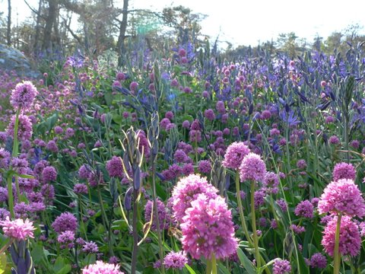

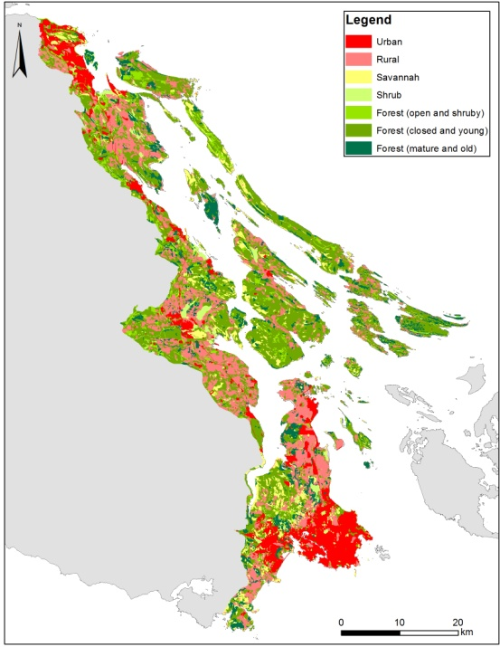
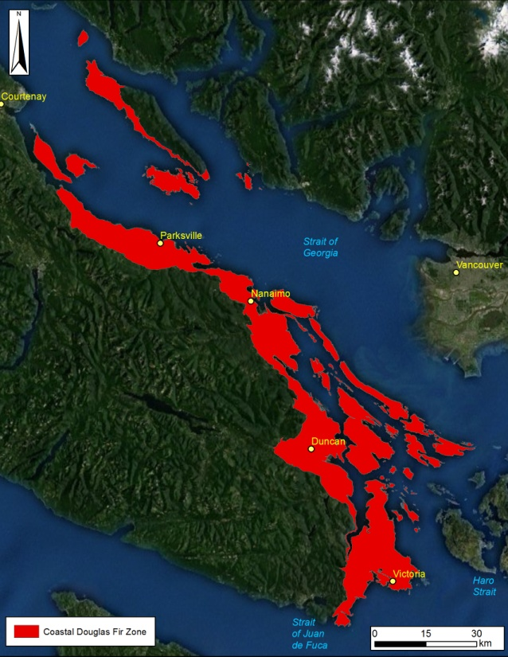
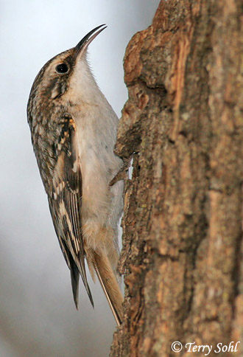
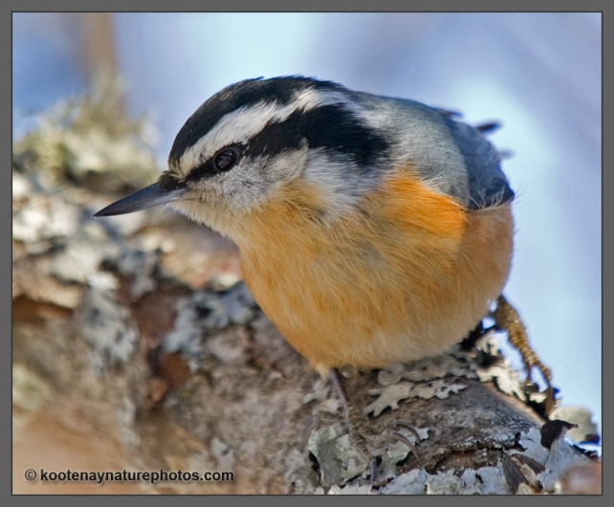

Species Distribution Models
Richard Schuster
Liber Ero Fellow
Geomatics and Landscape Ecology Lab
Carleton University

Slide 2
Species Distribution Models
Ecological question: What is the species occurrence probability in an area?
Some uses:
Estimating occurrence or abundance patterns
Ecological restoration
Risk and Impacts of Invasive Species
Reserve design and conservation planning

Slide 3
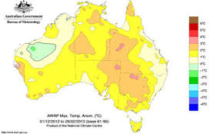

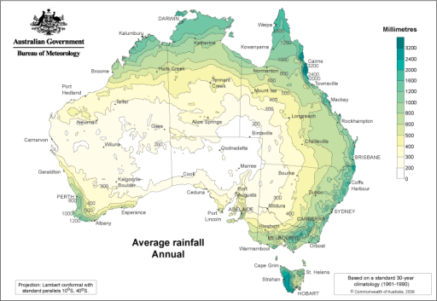
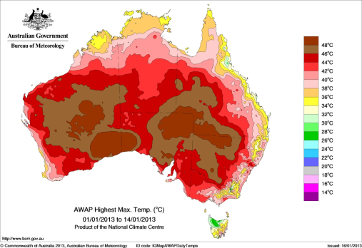
Predictive modelling of species geographic distribution based on the environmental conditions (Phillips et al 2006).
Main Assumption: Species distribution are predictable from environmental variables.
Ocurrence probability $=f\left(environmental conditions\right)$
Species Occurrences
(geographic coordinates X,Y)
Prediction
Response variable:
Probability of presence
Covariates: Environmental data
Maria Angelica Lopez-Aldana 2015

Slide 4
SDM: Data types and methods
Type of data
Presence/absence data
Detection/non-detection data
Presence only data
Herbarium or museum data
ManEnt, Maximum Entropy
Repeat visits to a site
Systematic Biological Survey
GLM/GAM
Site-occupancy models
BRT/RF

Slide 5
Presence-only data
Known occurrences (presence) of species
No known absences
Sampling bias, opportunistic observations
Use of such data often justified by the lack of systematic survey data
53% of SDM papers still use these data¹
41%¹ use MaxEnt (Phillips et al. 2006)
1) Guillera-Arroita et al. 2015

Slide 6
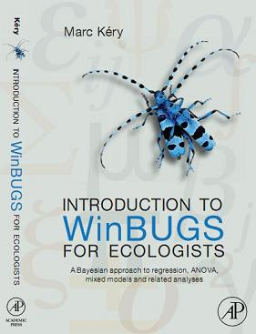
Presence/absence data
Know occurrences of species
Known ‘absences’
Family of correlative models
Many = regression-like
Assumption:
species’ occurrence or abundance can be modeled using additive combinations of predictors
Use (largely) environmental information to explain observed patterns of species occurrences (Elith and Graham 2009)

Slide 7
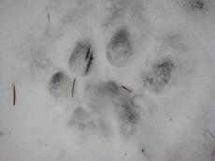
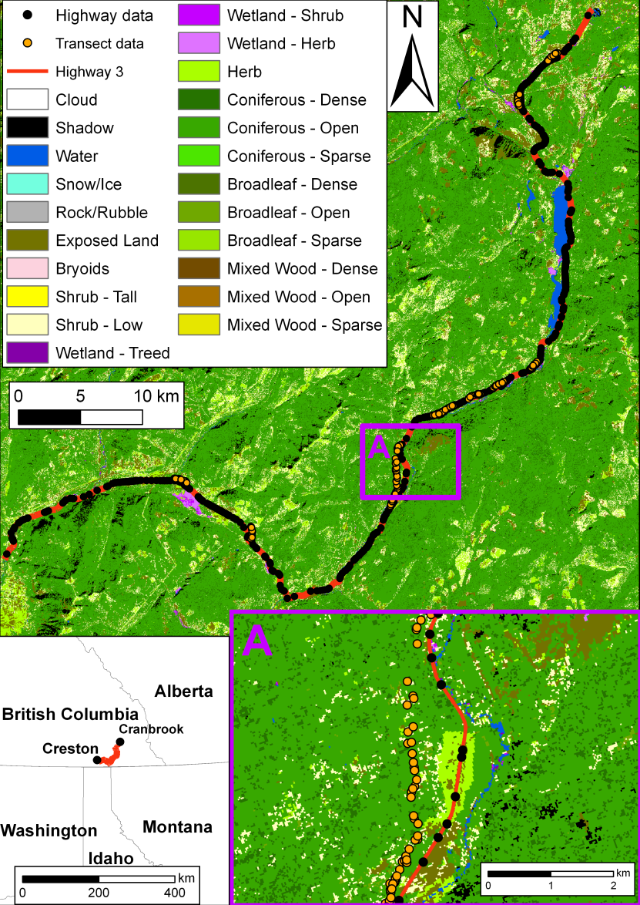
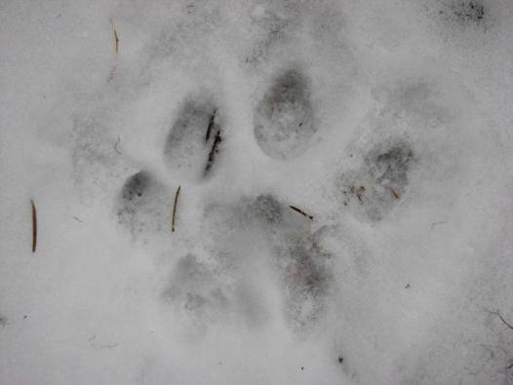
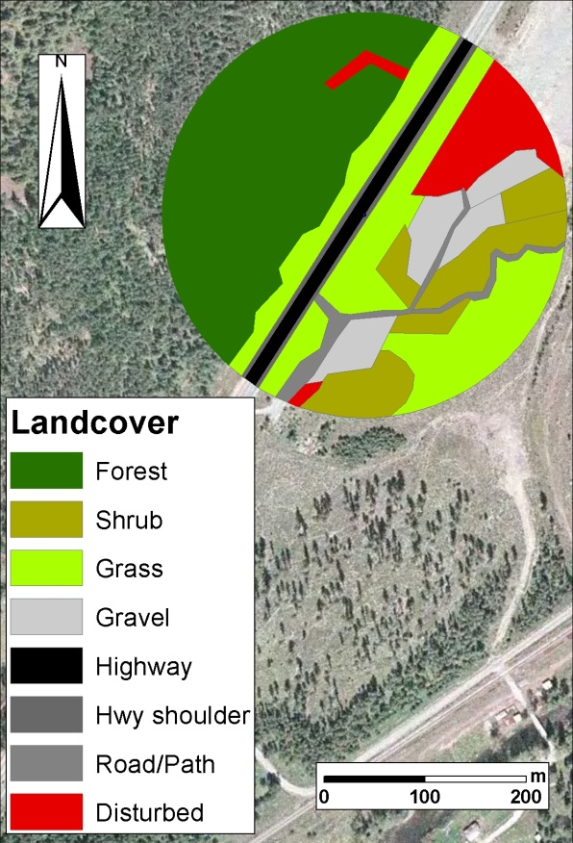
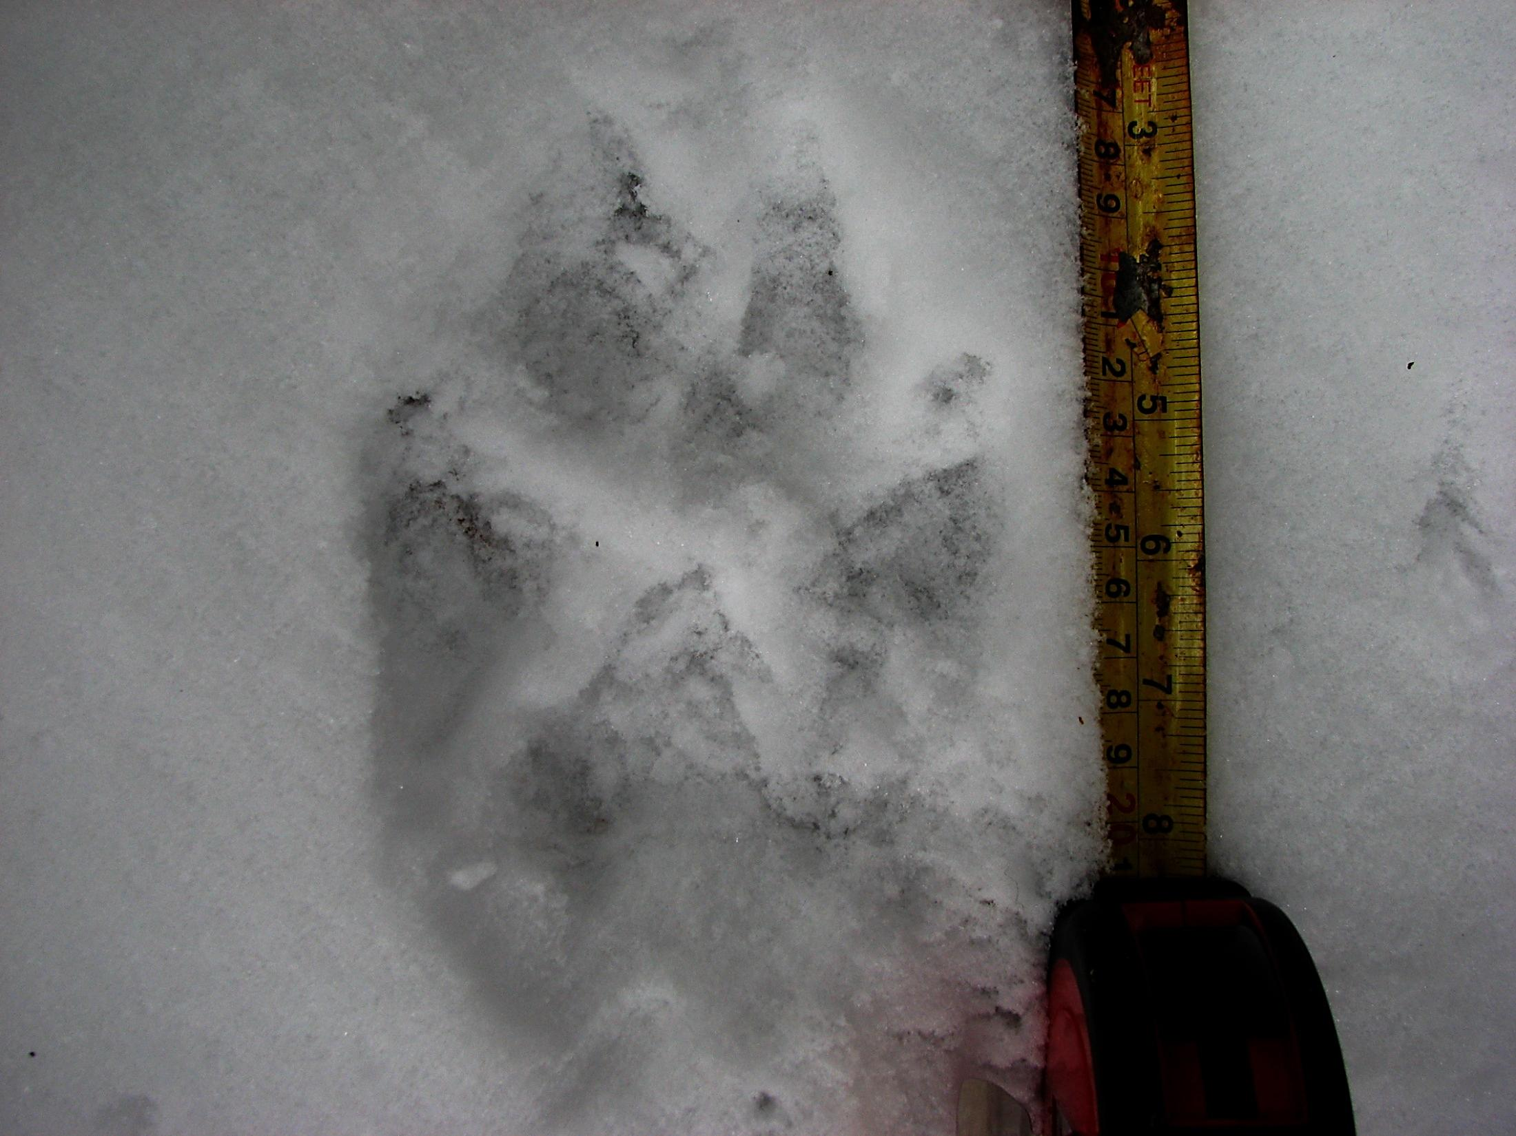

Multiscale highway effects on a large mammal community
Schuster, Römer & Germain 1 (2013) PeerJ e189

Slide 8
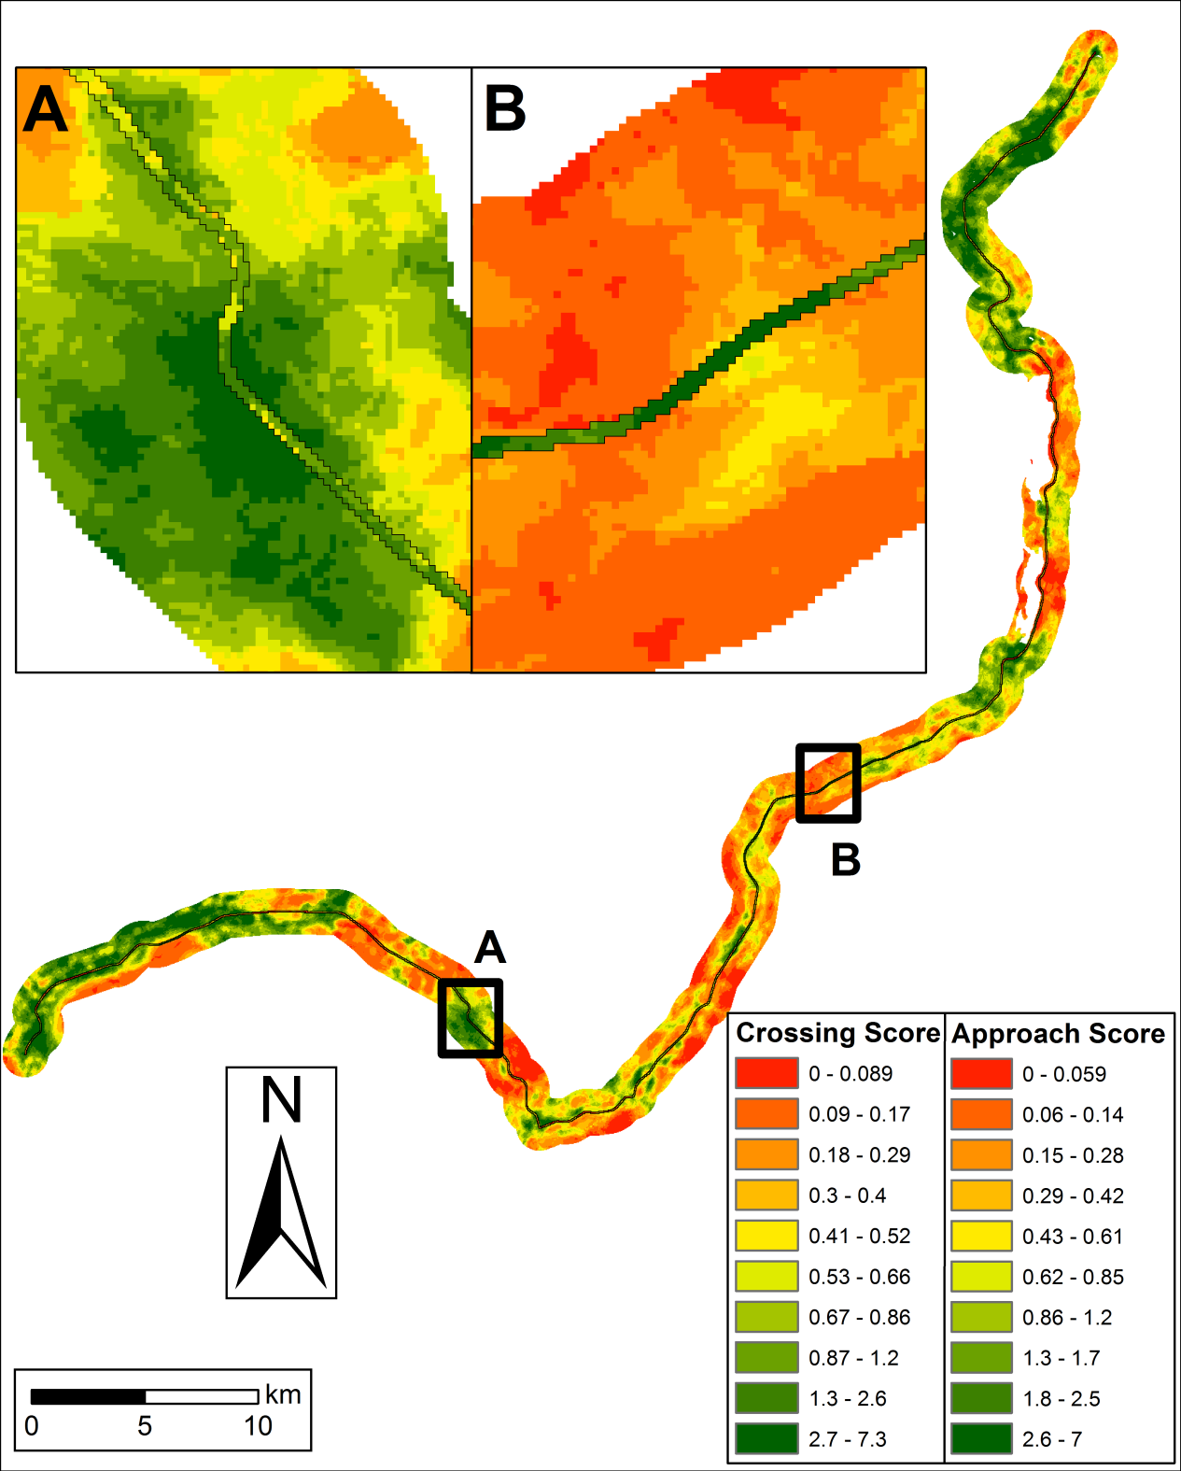

Slide 9
Presence/absence data II
More recent developments use machine learning approaches, e.g. boosted regression trees (BR) (Friedman et al. 2000).
Boosted regression trees combine the strengths of two algorithms:
regression trees (models that relate a response to their predictors by recursive binary splits)
boosting (an adaptive method for combining many simple models to give improved predictive performance).
Can be used for SDM’s

Slide 10
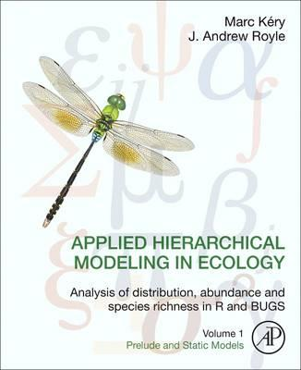
Detection/non-detection data
Fundamental + widely overlooked issue in SDM’s: detectability of most species is imperfect (Kéry 2010).
Site-occupancy models:
record detection and non-detections
Repeat visits to each site (Mackenzie et al. 2002, 2006)
These types of models specifically take imperfect detectability into account

Slide 11
Single Season Model
Consider the data consists of 2 ‘layers’
True presence/absence of the species.
Observed data which is conditional upon species distribution.
Knowledge about the first layer is imperfect.
Must account for the observation process to make reliable inferences about occurrence.

Slide 12
Model Development
Field Observations
000
000
010
001
000
000
110
000
000
000
101
111
Biological Reality
MacKenzie 2011

Slide 13
Single Season Model
ψ (psi) = probability a site is occupied.
p_{j} = probability species is detected at a site in survey j (given presence).

Slide 14
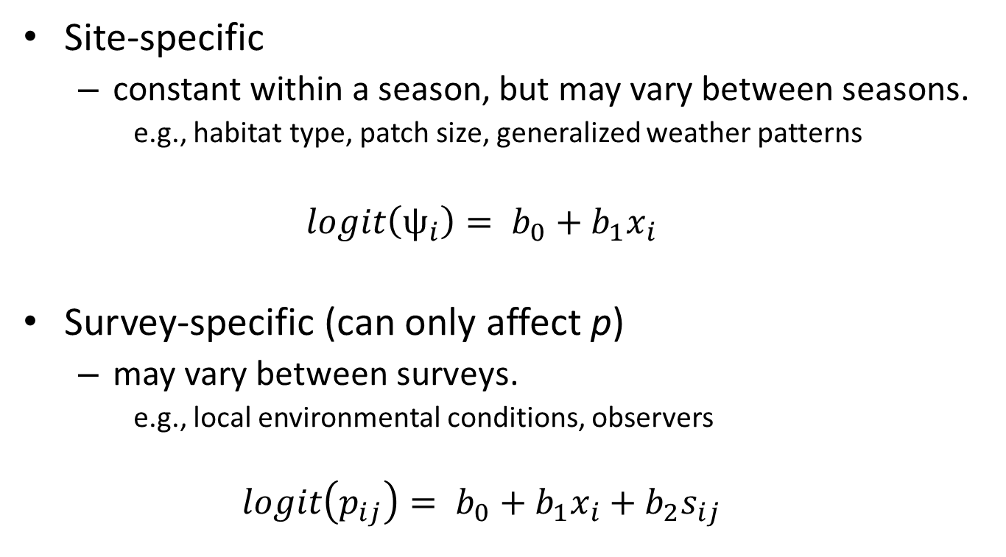
Covariates
Site-specific
constant within a season, but may vary between seasons.
e.g., habitat type, patch size, generalized weather patterns
$$logit\left(ψ_{i}\right)= b_{0}+b_{1}x_{i}$$
Survey-specific (can only affect p)
may vary between surveys.
e.g., local environmental conditions, observers
$$logit\left(p_{ij}\right)= b_{0}+b_{1}x_{i}+b_{2}s_{ij}$$

Slide 15
Model Assumptions
Closure
Can be relaxed using colonization/extinction model
Species identified correctly (no false detections)
Can be relaxed allowing false-positive estimation
No unmodelled heterogeneity
Can be relaxed for e.g. spatial correlation
Surveys are independent
Might be a systemic issue -> no model accounts for this.

Slide 16
SDM’s in the CDF

Slide 17
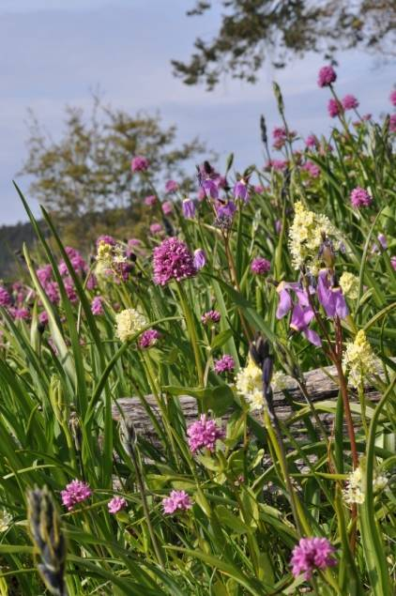
Use SDM’s in Conservation Area Design
Inform conservation decision-making
Identify good + efficient actions in space + time
Optimize allocation of finite resources
Moilanen et al. (2009)

Slide 18
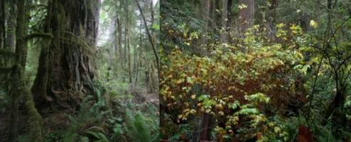
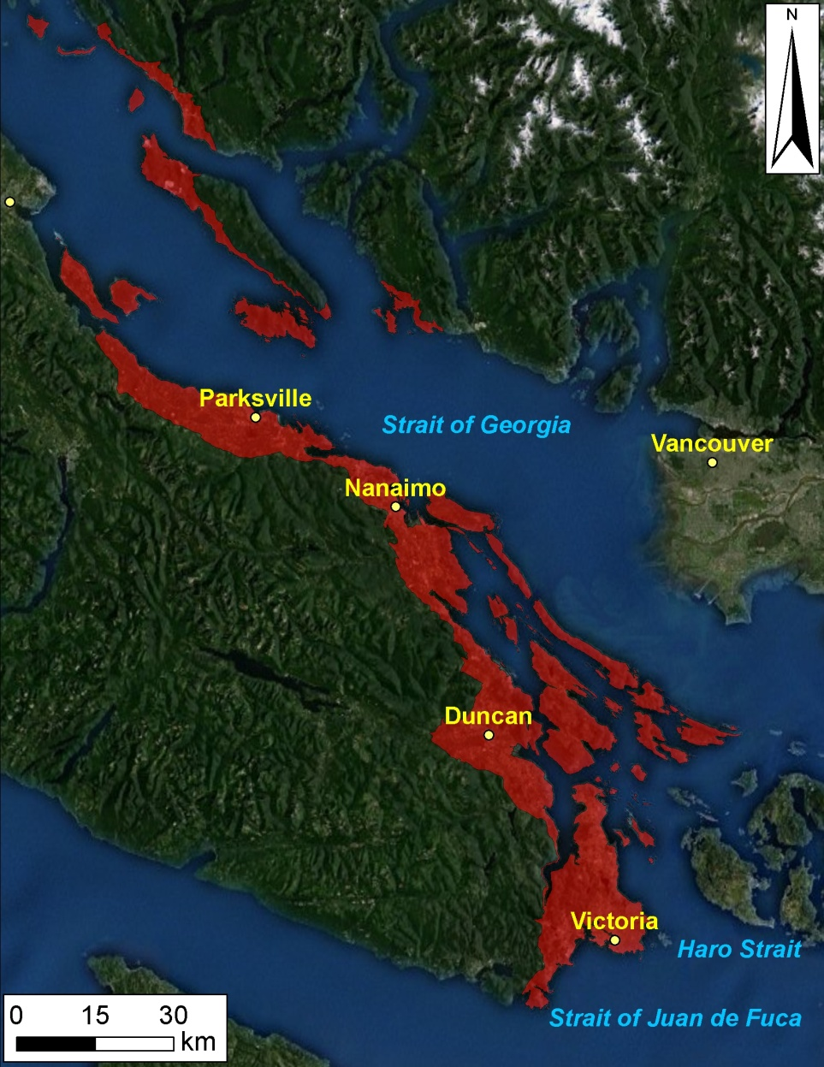
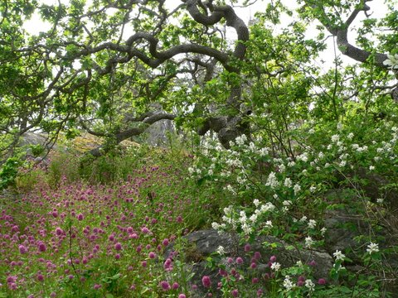
Coastal Douglas Fir Biogeoclimatic zone
Most Imperilled Ecosystem in BC
>60% Converted to Human Use
~84% Private Land
115 ‘Species At Risk’
Study area: ~2500 km²
Austin et al. (2008); Madrone Env. Services (2008)

Slide 19
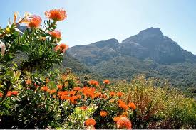
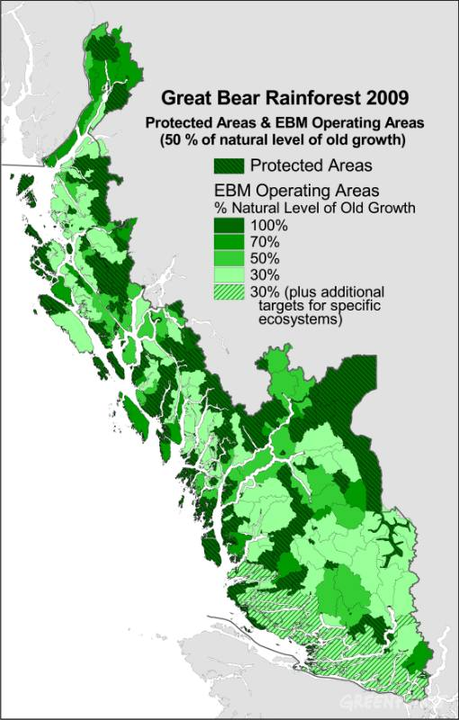
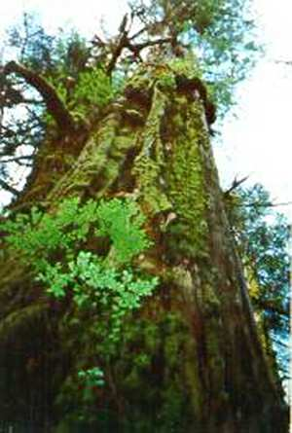
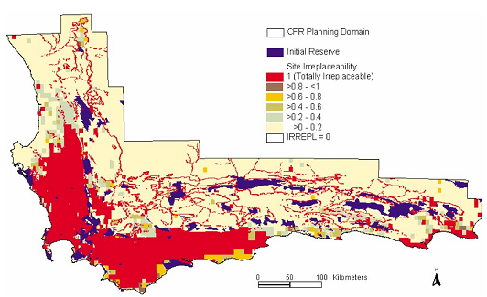
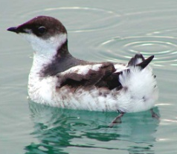
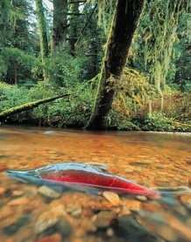
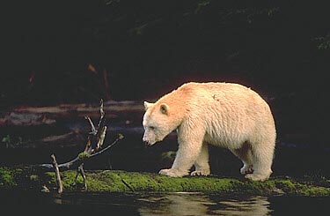
Traditional Approach of Conservation Area Design
Prioritize and conserve ‘Intact’ or ‘Relic Ecosystems’
Multiple criteria
Decision support tools
Impractical in CDF
- No Intact Habitats or Benchmarks
- Few reliable surveys of ‘Species At Risk’
Cape Floristic Region
Great Bear Rainforest
Gonzales et al. 2006
Cowling et al. 2003
McAllister

Slide 20
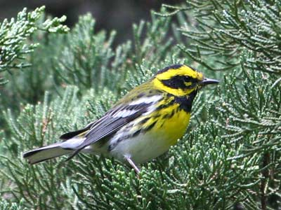
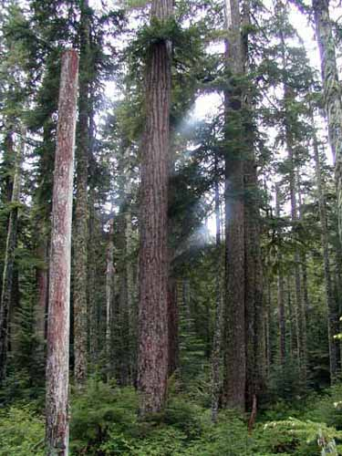

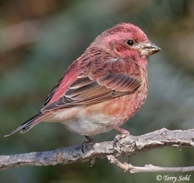
Use Indicator Species to Identify Areas that Support Historically Representative Communities
Specifically
Native Old-forest communities
Insulated from Negative Human Impacts
Our Approach
Map Distribution of Wide-spread, Easily Detected Indicators
Use composite maps to identify areas most likely to support native, old forest communities

Slide 21
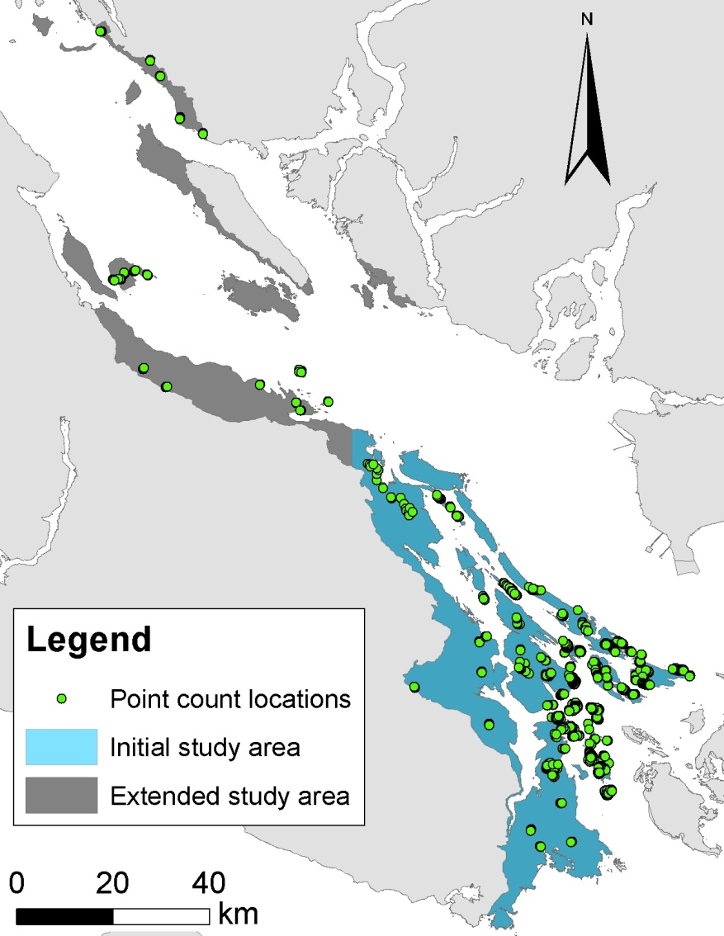
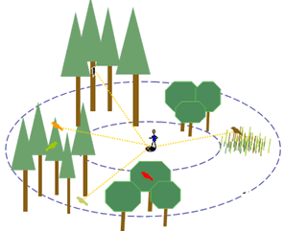
CDF Point Counts
2005 - 2011 (except 2006)
726 locations
Records for 80+ species
Record every bird heard or seen for 10‘ within 50m
5am – 12pm
Repeat visits
Source: USGS

Slide 22
Model covariates
Coarse (1km) and fine scale (100m)¹
25 landscape covariates
Using: Hawth‘s Tools, ArcGIS, Geospatial Modelling Environment, R
¹Guisan and Thuiller, 2005; Jewell et al., 2007

Slide 23
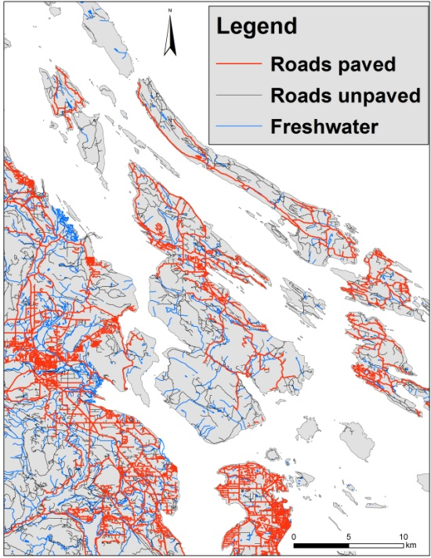
Landscape Covariates
Terrain Resource Information Management (TRIM)
Unpaved road length (100m, 1km)
Paved road length (100m, 1km)
Nearest road
Nearest freshwater
TRIM

Slide 24
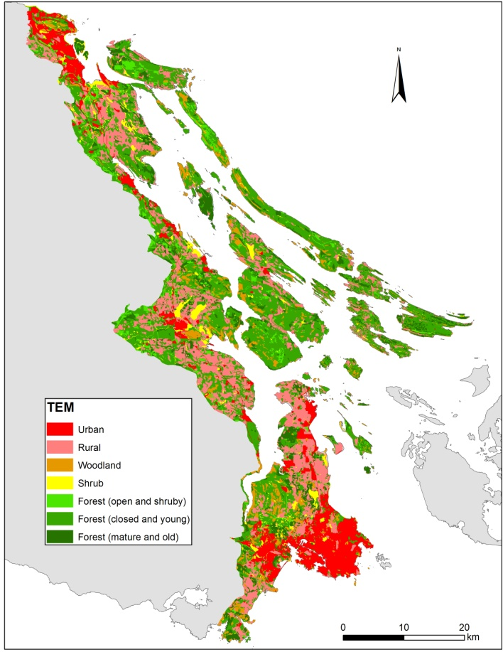
Landscape Covariates
Terrestrial Ecosystem Mapping (TEM)¹
Herbaceous (100m, 1km)
Shrub (100m, 1km)
Forest – closed and young (100m, 1km)
Forest – mature and old (100m, 1km)
Savannah (100m, 1km)
Wetland (100m, 1km)
Rural/agriculture (100m, 1km)
Urban/industrial (100m)
Distance to nearest urban
TEM
¹MES, 2008

Slide 25
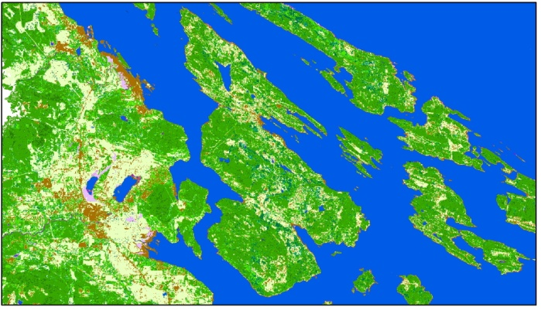
Landscape Covariates
Earth Observation for Sustainable Development (EOSD)¹
Landsat based
Crown closure within a 100m buffer, combining EOSD crow closure categories (dense, open and sparse) into one measure
Air photos
Island size
Nearest shoreline
EOSD
¹Wulder et al., 2008

Slide 26
Occupancy and detection models
Account for imperfect detectability
A “law” of ecology: you never see them all!
Two part models: Occupancy and Detectability (Mackenzie et al., 2002)
Assumptions:
Closed populations
No false detections
Detections independent
R package unmarked (Fiske et al., 2010)

Slide 27
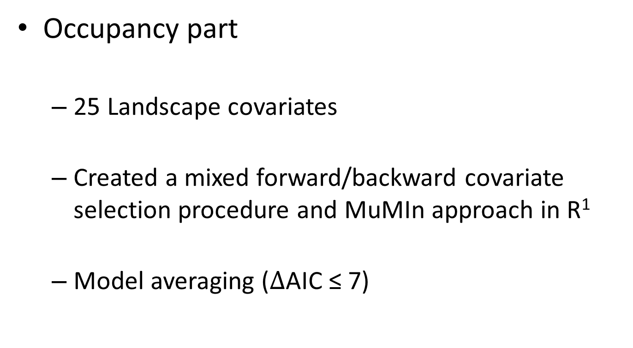
Occupancy and detection models
Occupancy part
25 Landscape covariates
Created a mixed forward/backward covariate selection procedure and MuMIn approach in R¹
Model averaging ($∆$AIC ≤ 7)
¹Schuster and Arcese, 2013

Slide 28
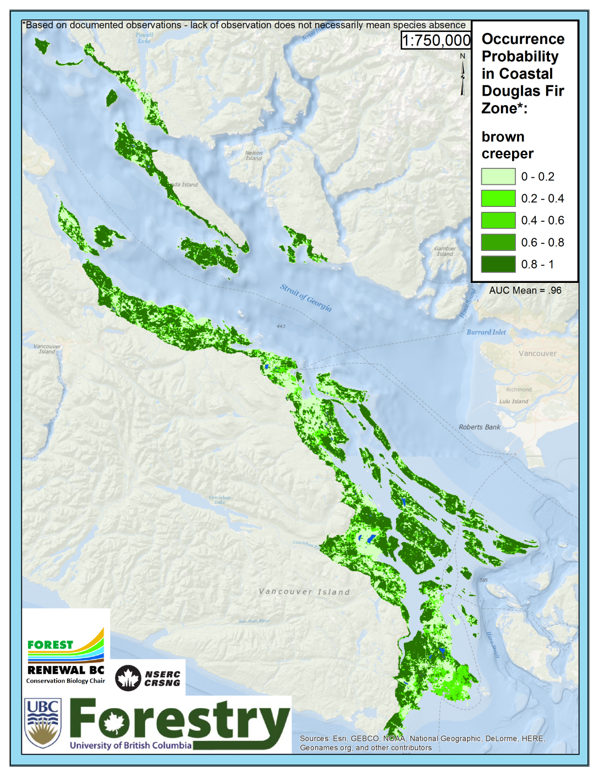

Brown Creeper
Positive:
Crown closure
Herbaceous
Young forest
Island Size
Negative:
Unpaved roads
Shrub
Wetland

Slide 29
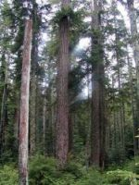
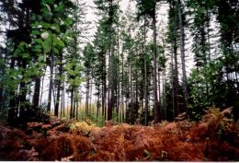
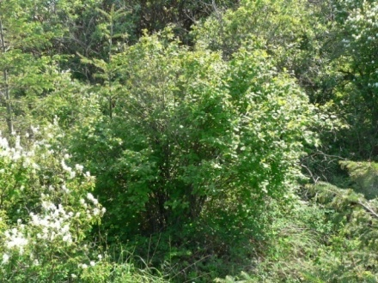
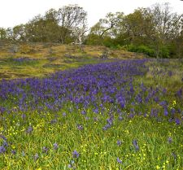
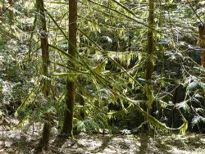
Expert ranking of bird species habitat associations
Online and Excel survey
12 expert birders
47 bird species
10 habitat types/structural stages
low/medium/high reliance
Notes:
https://www.surveymonkey.com/r/WPBVS9S
Richard Cannings, Sydney Cannings, Neil Dawe,
Katie Aitken, Russel Cannings, Karen Ferguson, David Green, Susan Hannon, Kelly Jewell, Tara Martin, Andrea Norris and Laura Sampson

Slide 30
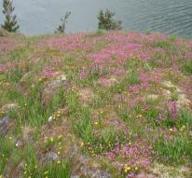
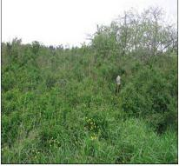
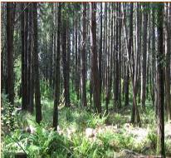
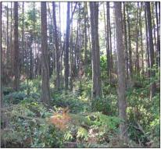
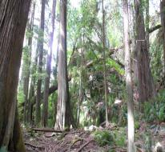
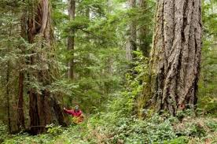
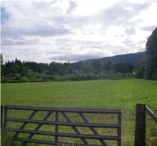



Habitat types
Herbaceous | Shrub/Herb | Pole/Sapling | Young Forest | Mature Forest
Old Forest | Rural/Agriculture | Urban/Industrial | Woodland | Wetland

Slide 31
Old Forest score example
Herbaceous
Shrub
Pole/Sapling
Young Forest (40-80y)
Mature Forest (80-250y)
Old Forest (>250y)
Old forest association =
Notes:
Richard Cannings, Sydney Cannings, Neil Dawe,
Katie Aitken, Russel Cannings, Karen Ferguson, David Green, Susan Hannon, Kelly Jewell, Tara Martin, Andrea Norris and Laura Sampson

Slide 32









Expert rankings
Species | Association Score | Map Weight
Brown Creeper | 0.81 | 0.11
Red-breasted Nuthatch | 0.79 | 0.11
Chestnut-backed Chickadee | 0.75 | 0.10
Golden-crowned Kinglet | 0.77 | 0.10
Pacific-slope Flycatcher | 0.63 | 0.09
Pine Siskin | 0.69 | 0.09
Townsend's Warbler | 0.69 | 0.09
Pacific Wren | 0.63 | 0.08
Purple Finch | 0.58 | 0.08
Yellow-rumped Warbler | 0.56 | 0.08
Olive-sided Flycatcher | 0.46 | 0.06
Wilson's Warbler | 0.06 | 0.01
Rufous Hummingbird | -0.07 | -
Song Sparrow | -0.36 | -
Spotted Towhee | -0.03 | -
White-crowned Sparrow | -0.66 | -
Dark-eyed Junco | -0.03 | -
Orange-crowned Warbler | -0.05 | -
Notes:
Richard Cannings, Sydney Cannings, Neil Dawe,
Katie Aitken, Russel Cannings, Karen Ferguson, David Green, Susan Hannon, Kelly Jewell, Tara Martin, Andrea Norris and Laura Sampson

Slide 33






Slide 34


Additional scores to date
(13 species)
(3 species)
Wetland (8 species)
Shrub (19 species)

Slide 35


Slide 36









Thank you
Notes:
36

